Slide 1
Naming the unnameable: making a difference around suicide prevention and mental health awareness and care
Gemma Andrews, Wellbeing and Public Health Manager Essex County Council
Suicide prevention and Public Mental Health Lead
Founder of the Southend Essex and Thurrock Suicide Prevention Partnership (strengthening how work with Southend and Thurrock)

Slide 2
Thank you for inviting me here today!
There are a lot of exciting ways we are going to be able to make a difference, together

Slide 3
The role of faith/belief spirituality in mental wellbeing
An understanding of the relationship between spirituality, religion and suicide is important in assessing and caring for those at risk.
Much of the evidence that religion provides a protective effect, helping people to cope with life stresses, reduce the incidence of depression and substance misuse, facilitate recovery , enhance social support and provide hope and meaning.
Evidence looking at outcomes across all faiths is limited - We need to work with the faith community to better understand how we can be considerate and effective in considering religious teachings on suicide, to have the biggest impact.
Protective factors: sense of belonging and community, meaning and purpose that is not defined by work or individual relationships (stability), accountability and responsibility to a higher being
Risk factors: shame and risk of loss of community in the event that MH is a barrier to worship.
Cook, C. (2014). Suicide and religion. British Journal of Psychiatry, 204(4), 254-255. doi:10.1192/bjp.bp.113.136069

Slide 4
My role within the SET Suicide Prevention Partnership is to:
Work with a variety of organisations and stakeholders to ensure that we have the most comprehensive understanding around:
- historical and emergent drivers for suicide impacting our communities i.e. ‘who is at risk? What does suicide risk look like?’
- the impact of loss by suicide on communities and individuals
- what we can do, together, to make a difference moving forwards
Some of you will remember I came to talk at Essex Faith Covenant previously. We have been on quite the journey since then. Complete strategic buy in has been achieved, all partners are in agreement that we need to act. As a result, our insight has moved from focusing on why we should invest in prevention → what we should do to maximise our impact.

Slide 5
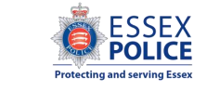
Southend Essex and Thurrock Suicide Prevention Partnership Board
Chaired by Jane Gardner, Deputy Police, Fire and Crime Commissioner for Essex, with support from Gemma Andrews, Essex County Council Public Health
Purpose:
Offers a vital collaboration space for suicide prevention system activity across greater Essex
Oversight of suicide prevention delivery and escalation of risks to delivery (funding loss)
Offers a trusted source of suicide prevention data analysis and expertise to the collaborative
in partnership with: Essex Public Health Intelligence Team, Research and Citizen Insight, Essex County Council

Slide 6
WHO DO WE WORK WITH
ESSEX POLICE CRIME COMMISSIONER ESSEX POLICE ESSEX HWB
ESSEX FAITH COVENANT NHS – NEE, MSE AND WE ICB EAST AMBULANCE SERVICE
NETWORK RAIL EPUT (MH PROVIDER) RNLI
COMMUNITY PHARMACY LIVED EXPERIENCE REPS
COMMUNITY ORGANISATIONS – CRAIG TYLER TRUST, TRUST LINKS, SAMARITANS, PAPYRUS
Social care – adults and Childrens ESAB Southend and Thurrock PH
Elected members including the Essex CC Lead member
District colleagues Strengthening Communities team ECC (Charlotte Britton)
Substance misuse services Housing DWP

Slide 7
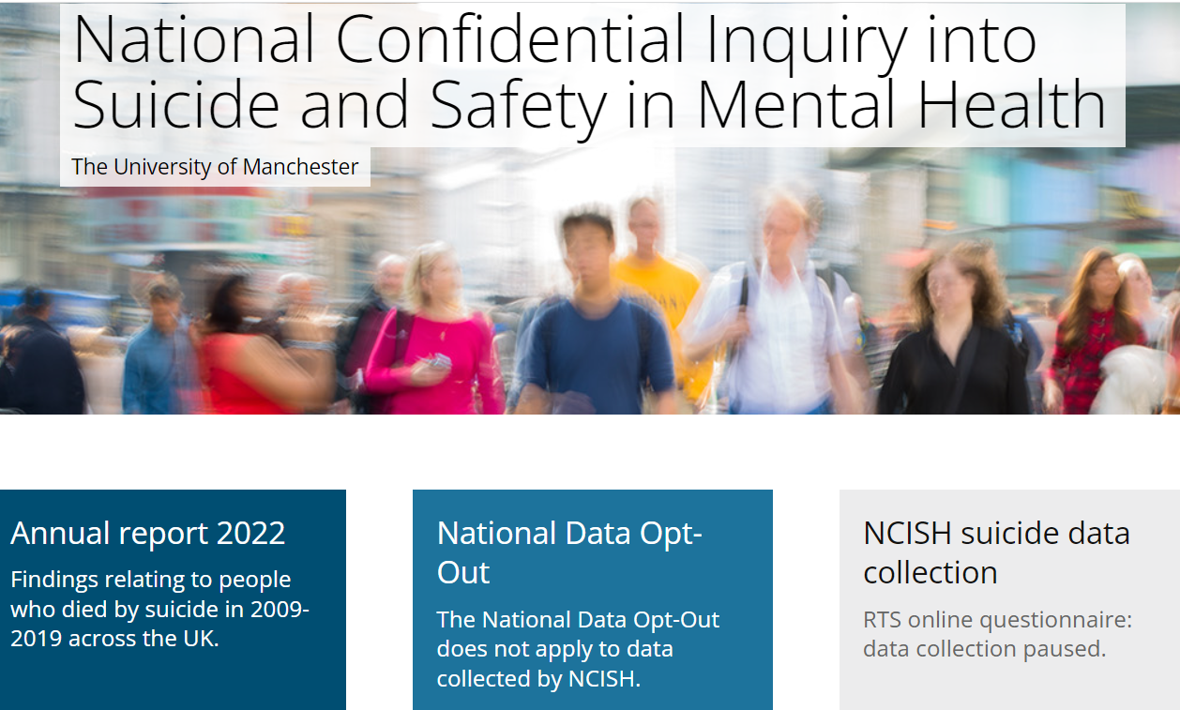
What we know about need
https://sites.manchester.ac.uk/ncish/

Slide 8
Public health advocate evidence based practice and pull information from national, regional and local sources. RTSS insight provides insight from April 21 to current day.
The high risk groups for us to consider when we are going about our day to day work in our communities:
History of self harm – majority (64%) of patients who died, especially in under 18’s (but not exclusively)
Nearly half (48%) lived alone
13% had made a single one off contact to MH services
9% died on or near to an anniversary/ significant date (relating to loss or trauma)
Suicides still occur in patients assessed by MH services as low or no short term risk, as assessment assesses suicidal ideation at time of presentation. This highlights the opportunity for people to have an impact outside of services, in day to day interactions
The highest risk is in the 2 weeks post discharge from mental health inpatient care
Recent economic adversity: financial problems (debt and lending), workplace problems, change in employment/ earning potential, homelessness
Relationship breakdown/ instability, familial, friendships, romantic (divorce and separation).
Addictive risk behaviours: gambling, substance misuse
Perceived threats and stress: covid 19, cost of living crisis, physical and sexual violence and crime (victims)
Unresolved shame as a factor in suicide drivers
Comorbid illness – physical health and pain
History of Domestic violence (victim or perpetrator)
Previous attempt
References: NHSE, NCISH, OHID Eastern region, SET SP Partnership Board data series (inc Essex RTSS)

Slide 9
STACKING FACTORS
Essex: Age and geographic patterns

Slide 10
Current work and it’s link to other organisations
Building understanding and narrative
RTSS data project in partnership with Essex Police, British Transport Police and Royal National LifeBoat Association
Lived experience insight, middle aged males and suicide attempts focused workshops
Case reviews and SI learning (attempts) – DV and complex needs, substance misuse and complex need and childrens review 2023 (CSC and CDOP)
REACTIVE WORK
An awareness of elevated prevalence in men, of all ages
NEE place pilot
NHSE funded Bereaved by Suicide service
Physical Health, including chronic LTC and life changing diagnosis
Pain management, including opiod weaning
GP/ Primary care support inc. timely reviews for MH medication
Linking into work in MH commissioning (community MH services, onward care pathways at a and e inpatient care)
Access to MH support at all tiers, GP (first door), IAPT referrals, community MH service, secondary care.
Domestic violence – local trends following national, existing multi partner efforts (Multi Agency Risk Assessment Conference)
ESAB links – agreeing a system wide definition of adult vulnerability, and appropriate system response.

Slide 11
GOLD STANDARD PREVENTION PRACTICE – LAYING A SOLID FOUNDATION
NHSE Wave funded prevention delivery projects
Samaritans Media Guidance work with local press organisations, inc Essex Live
Bereaved by suicide postvention service
Suicide profiles research with the University of Essex

Slide 12
Our offer to the community in terms of supporting improved awareness and impactful intervention
NCISH evidence base
Access to bimonthly anonymised thematic reporting
Access to our open data workshops with my team analyst (questions welcome)
Training – Zero suicide Alliance Essex – free
ASIST
PABS – supporting people bereaved by suicide
New upcoming services that can support people in the community
Understanding how to support individuals to get early help
Understanding the modifiables in mental wellbeing and mental ill health - MH first aid training
Understanding how you can help in crisis – safety plans (Samaritans)

Slide 13
Thank you for listening
Questions?

